Slide 1
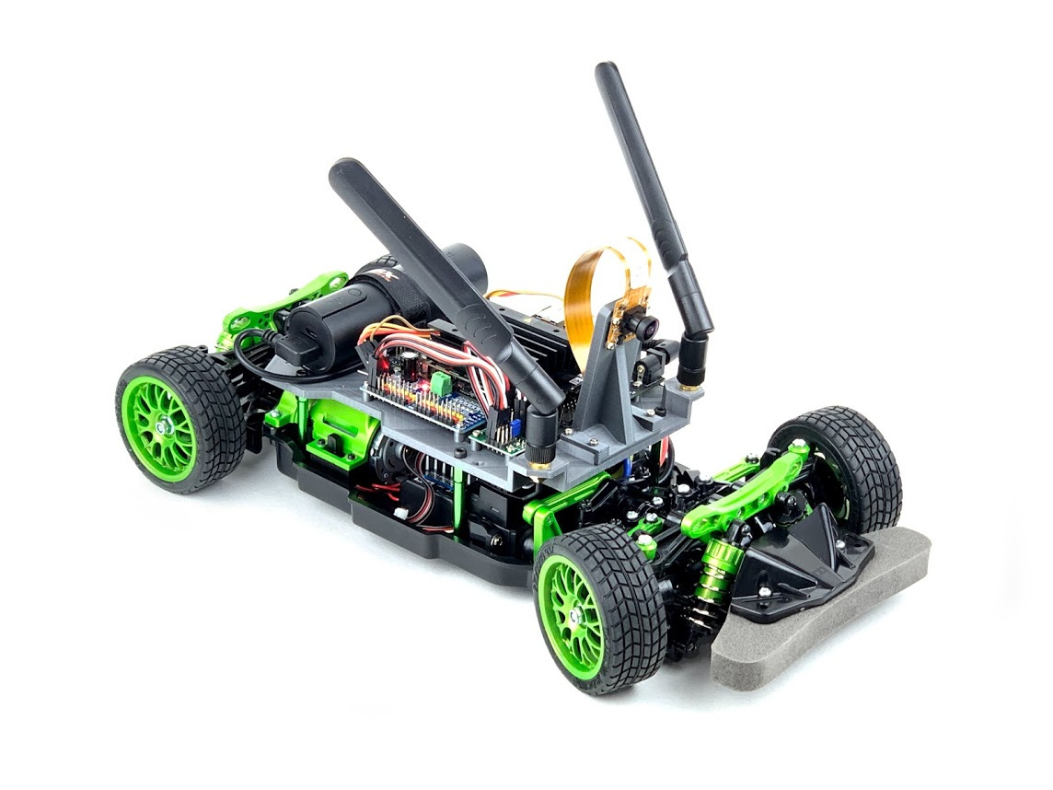
Custom JetRacer
Kanan Aliyev

Slide 2
What I wanted to do
I wanted to do something that I am passionate about
Something complex that has many aspects to it, to see if I could still do it
To not forget that I have somebody who can help me

Slide 3
Why JetRacer?
The main reason why I chose to pursue this project was because I did not think I would be able to pull it off, at least not all of it.
I wanted to see how the other side lived.
The field of robotics is producing fascinating things that may make our lives much better or not. I am here for all of it, and so should you.

Slide 4

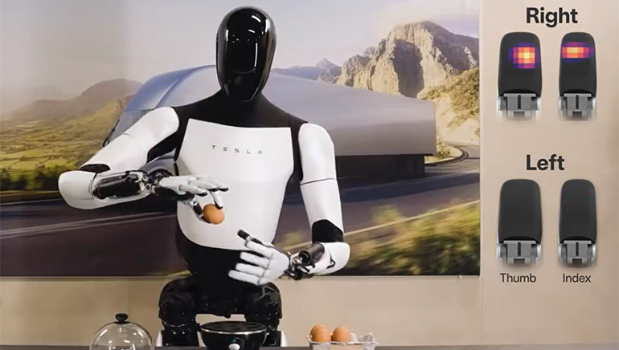
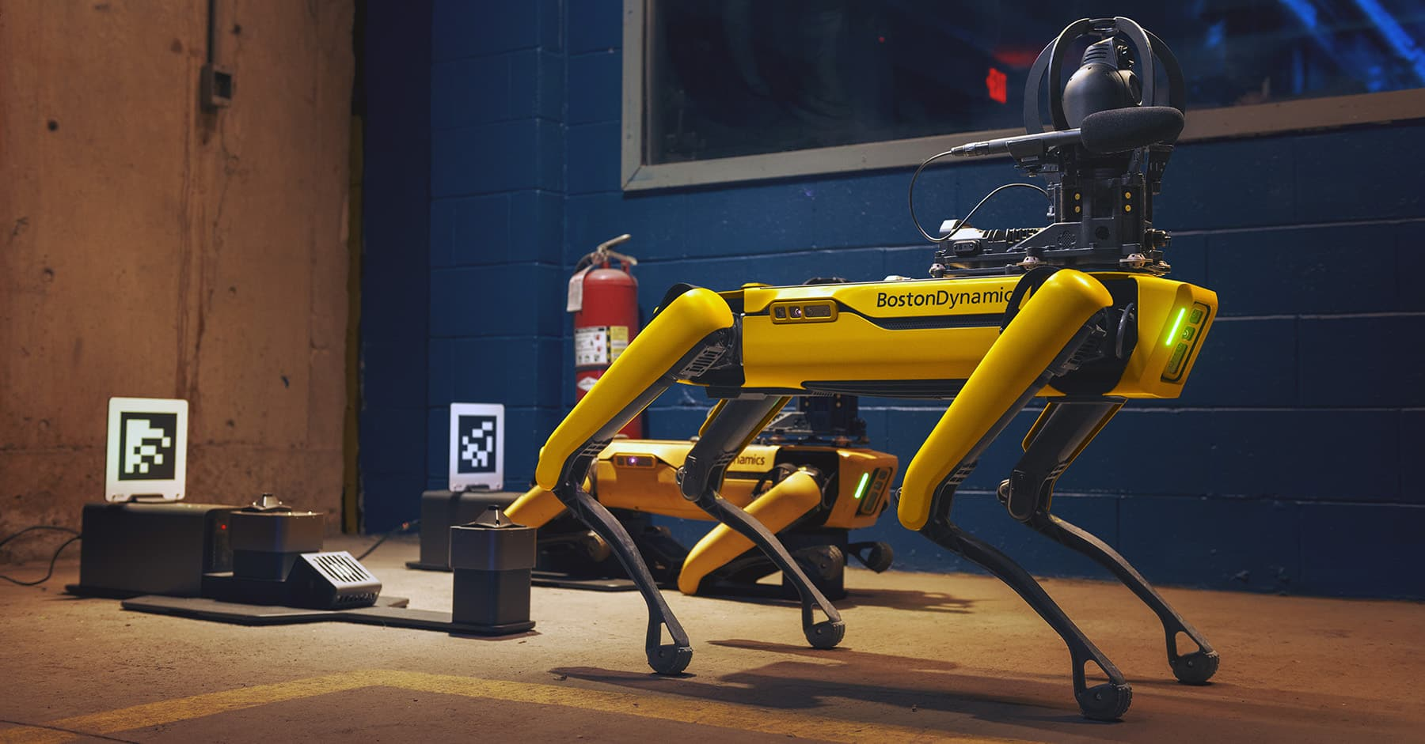

Quick Storytime

Slide 5
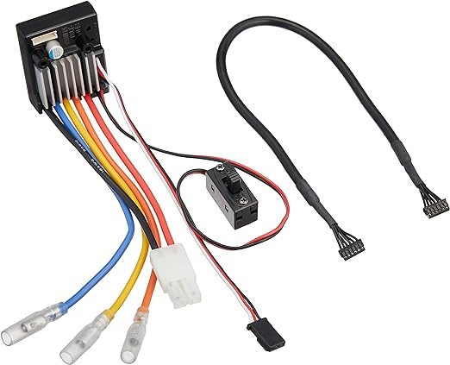
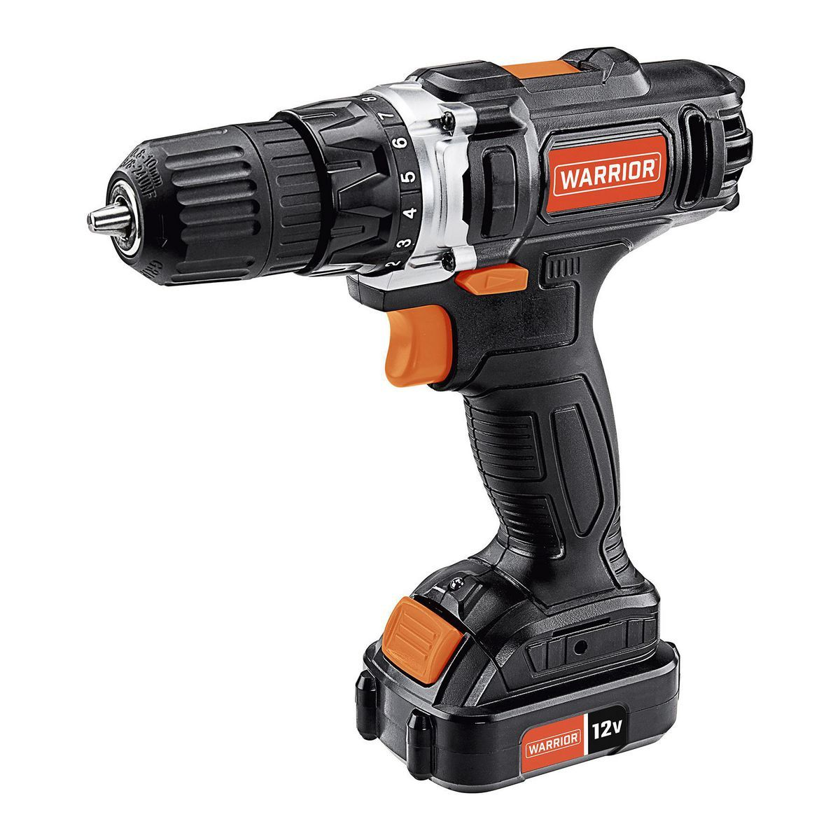

What happened…
Find compatible hardware and assemble a racecar
Test and make sure it can be remote-controlled and is fully functional
Add hardware that would allow onboard computing
Test again and confirm that the additional hardware did not bring new issues
Set up and maintain a connection to the onboard computer
Once connected, give basic commands and get a sense of movement
Implement data gathering, set up a circuit, and collect data on the circuit
Train different deep learning models on the data and simulate the results
Finally, test run the car and film the best runs

Slide 6
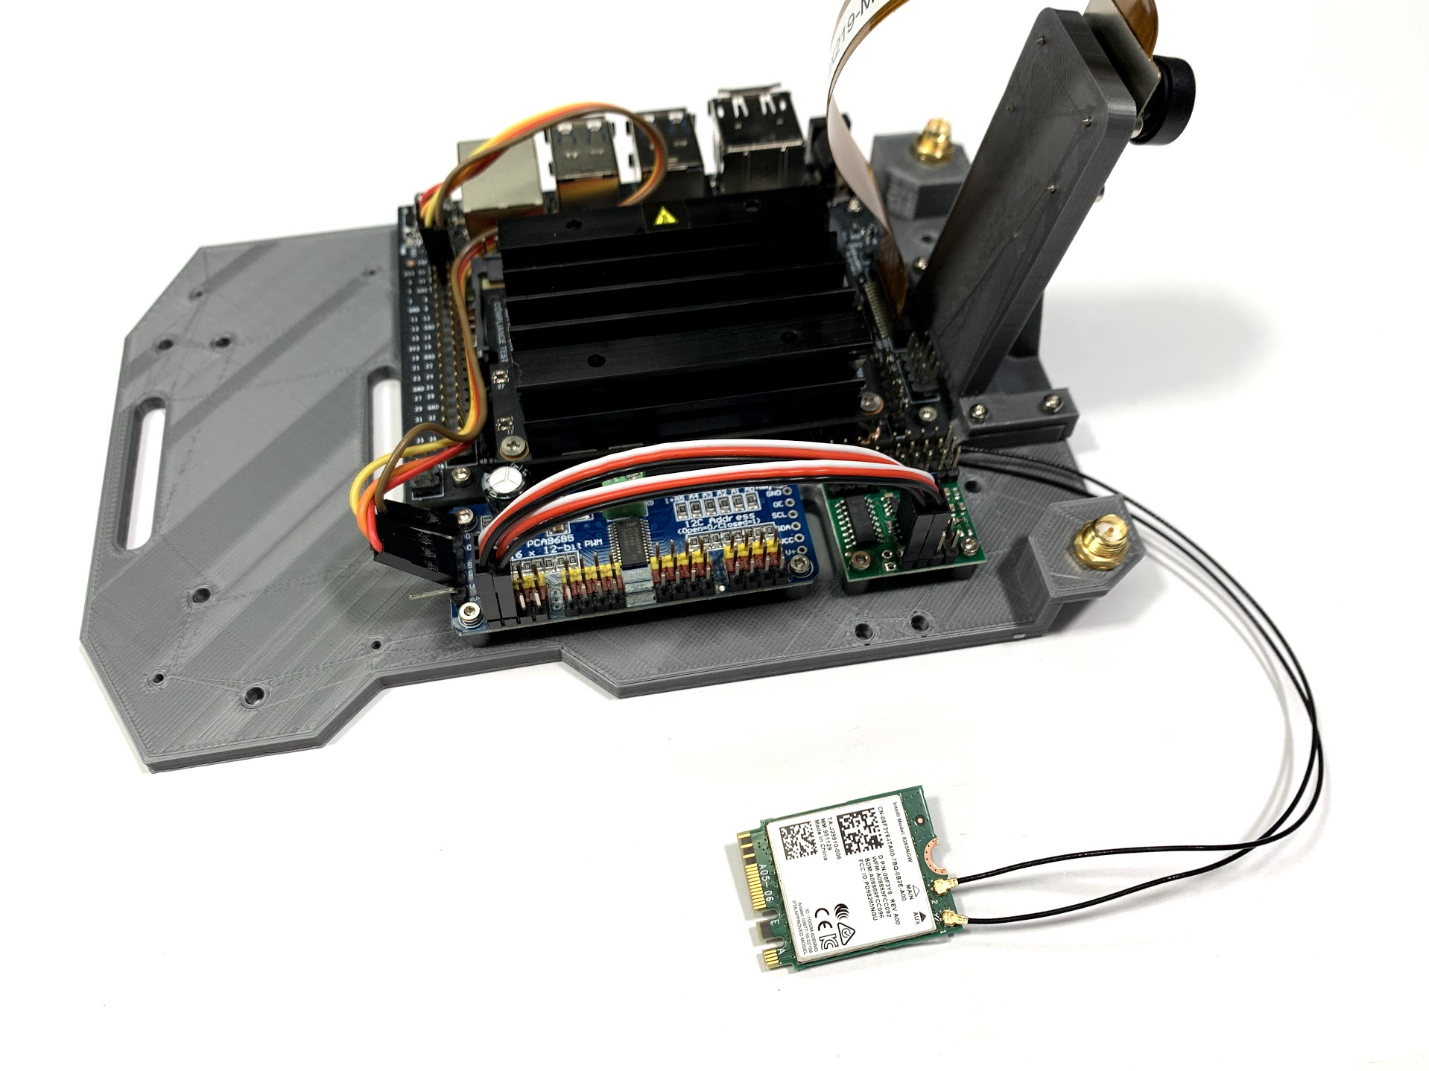

Slide 7
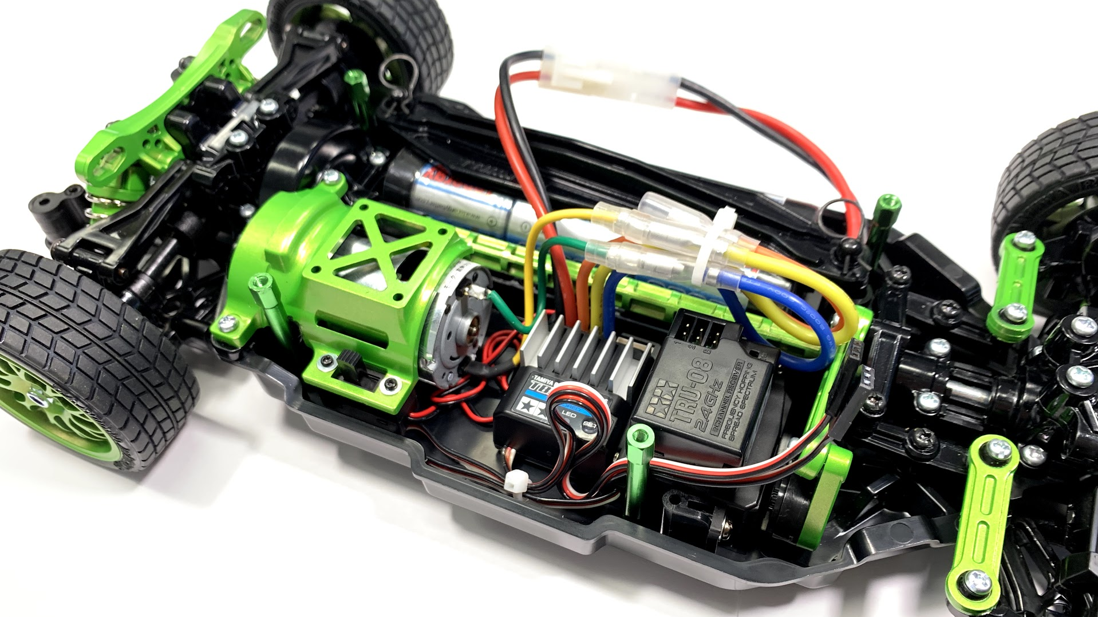

Slide 8
Future Work
If I had more time and resources to spend, I would try and implement reinforcement learning instead of vanilla deep learning
Improve the way how I connect to the car so that I have more freedom of operation
Make the car more resilient

Slide 9
Questions?

